Slide 1
Color Spectrum

Slide 2
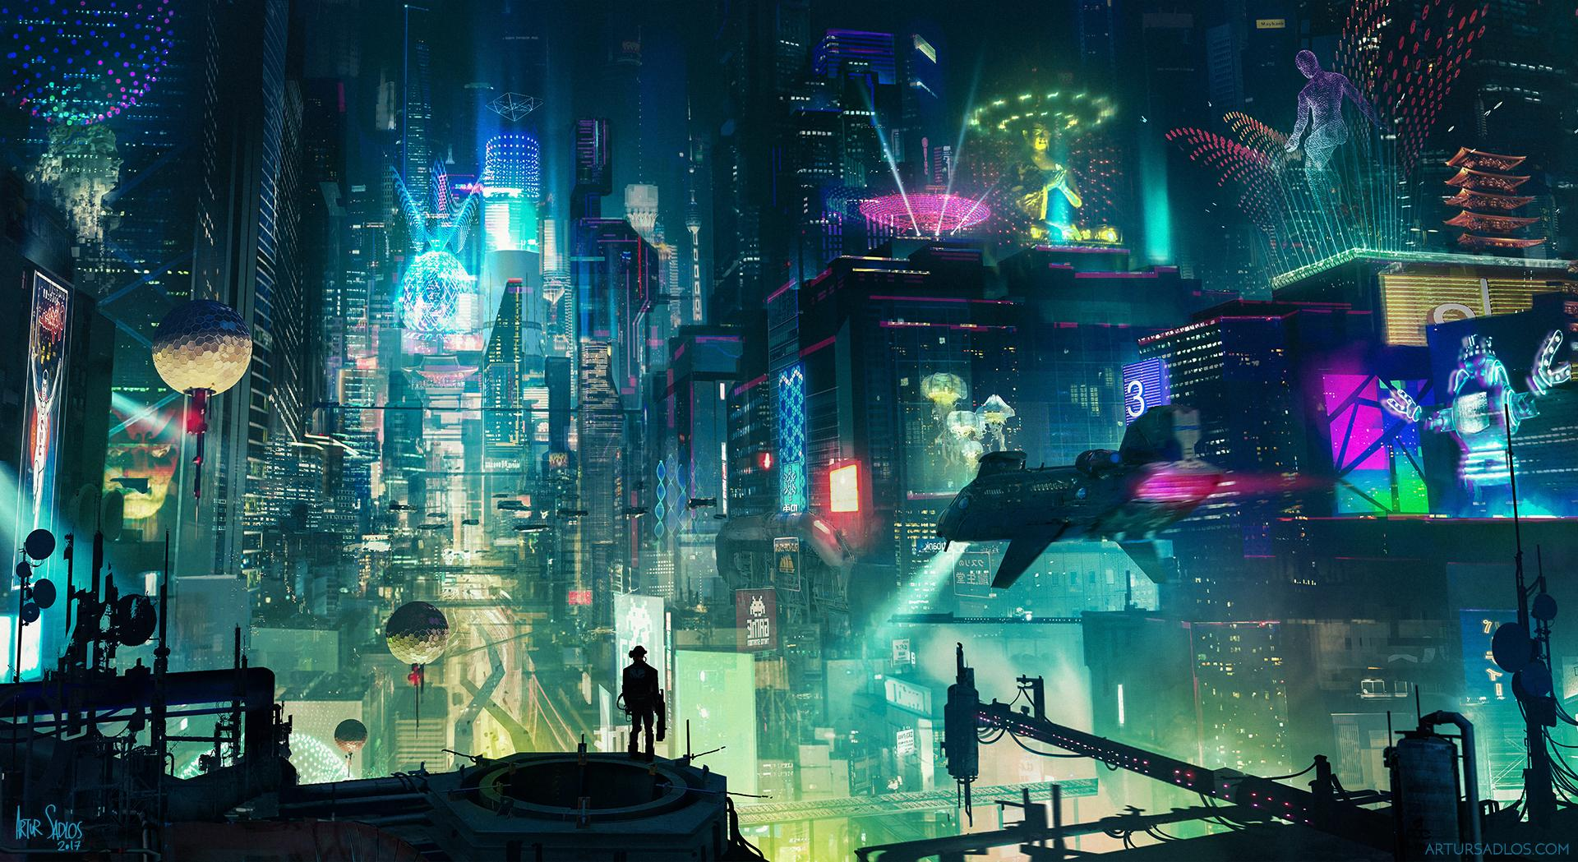
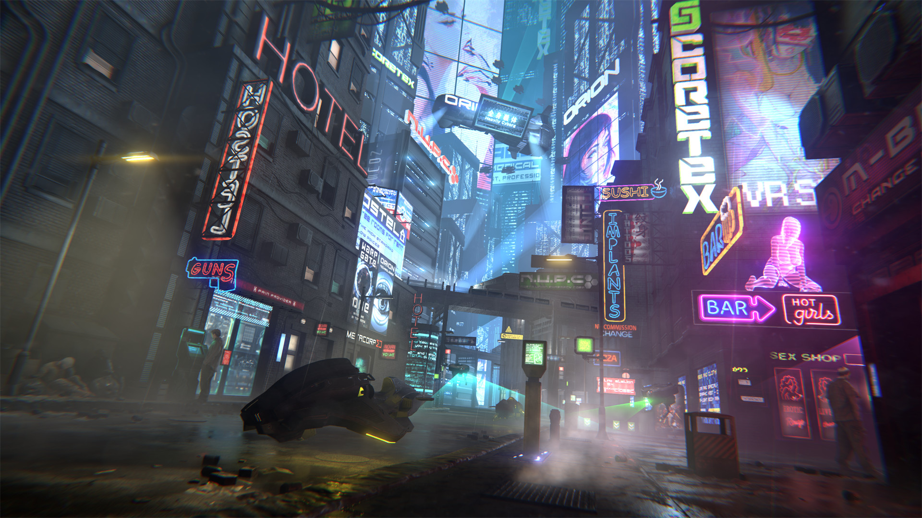
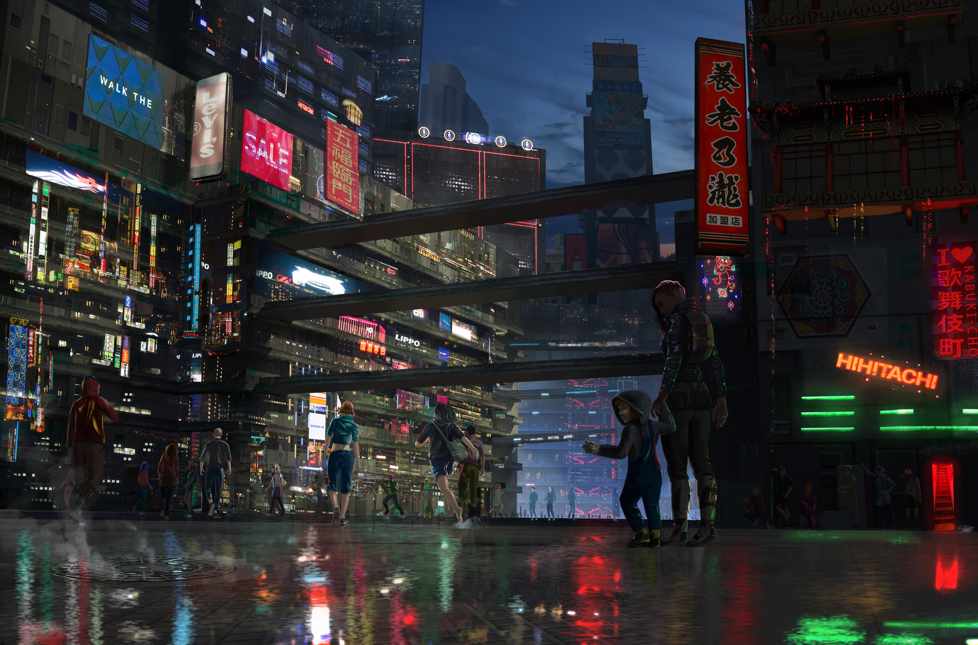
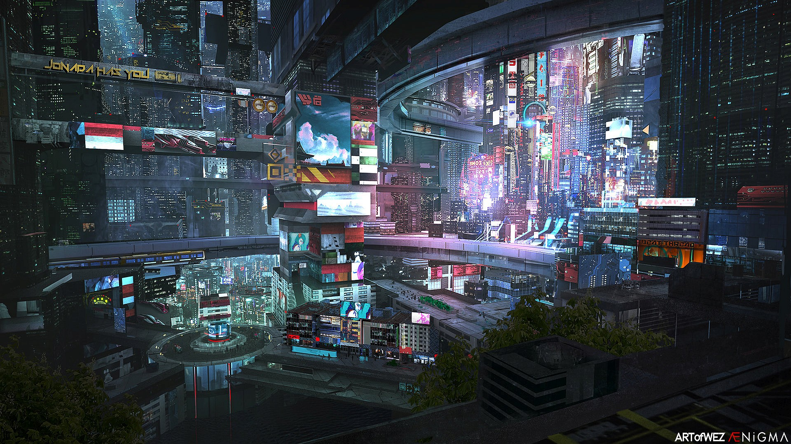
Cyberpunk Style

Slide 3
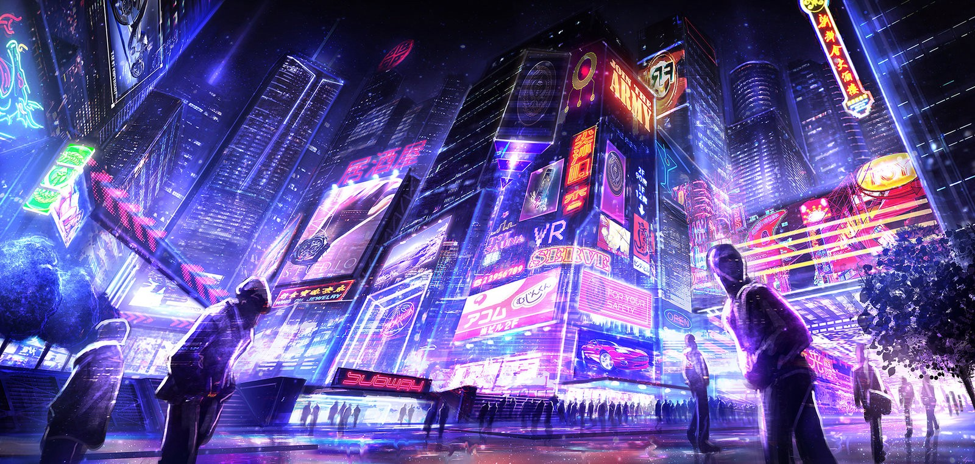
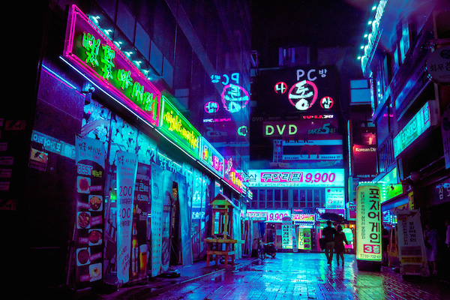
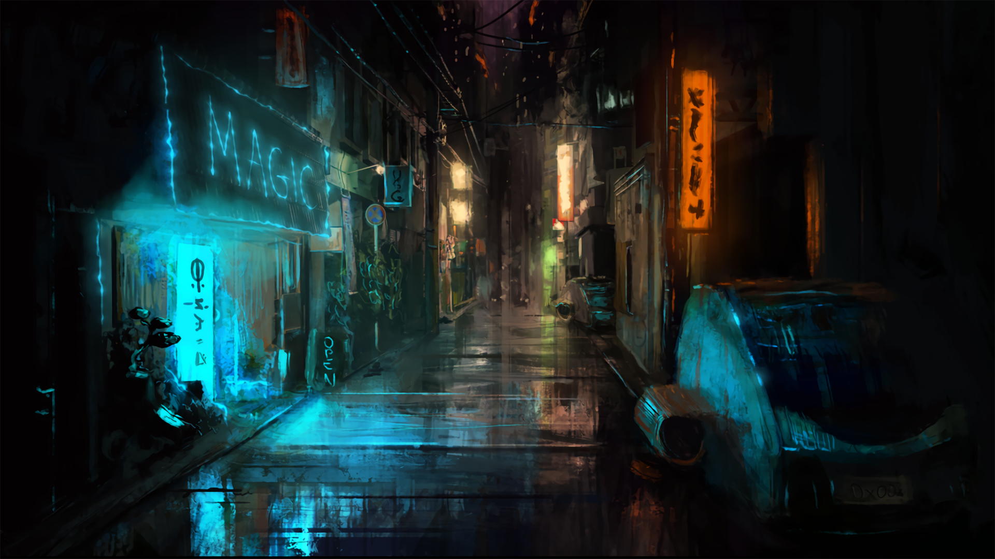
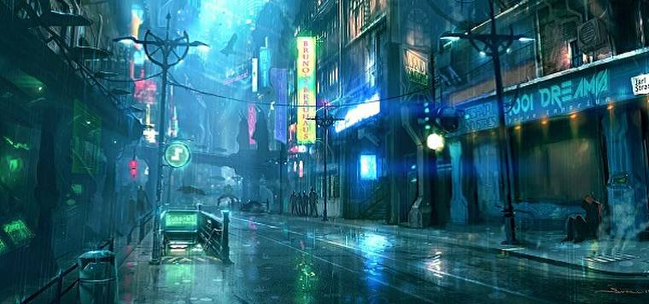
Cyberpunk Style

Slide 4
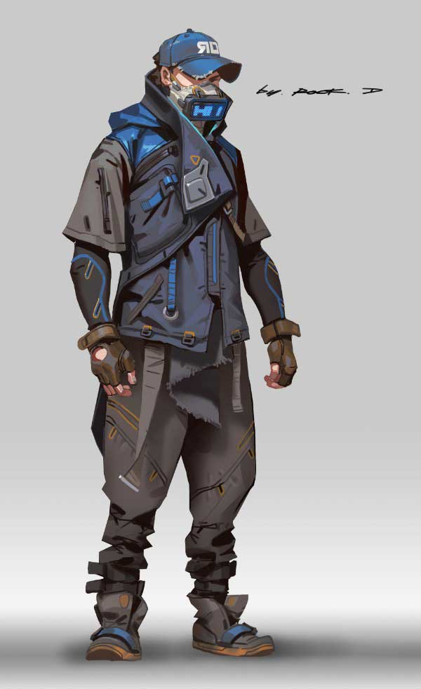
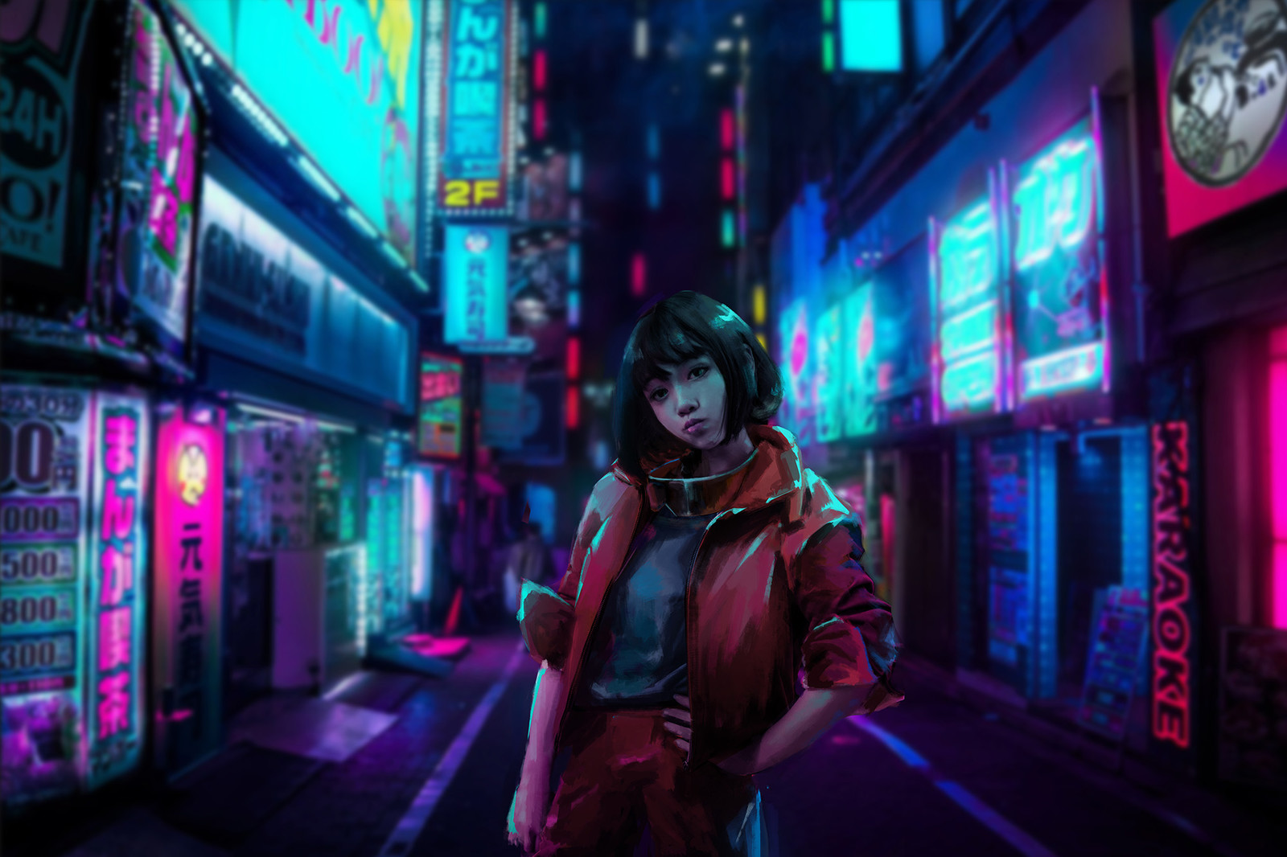
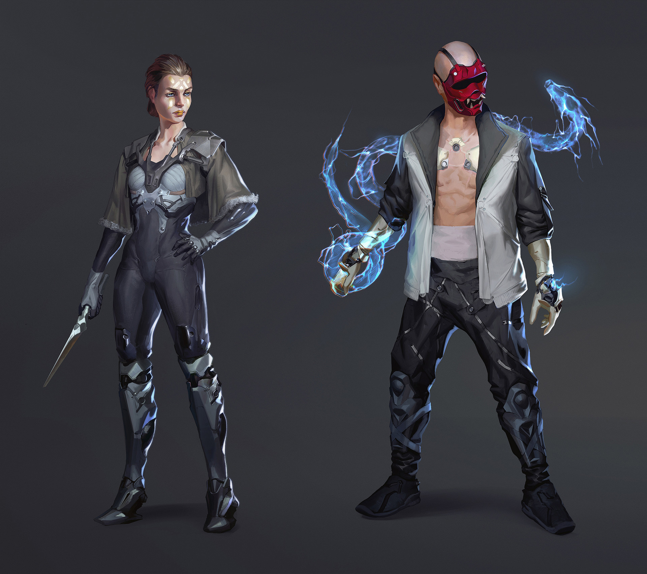
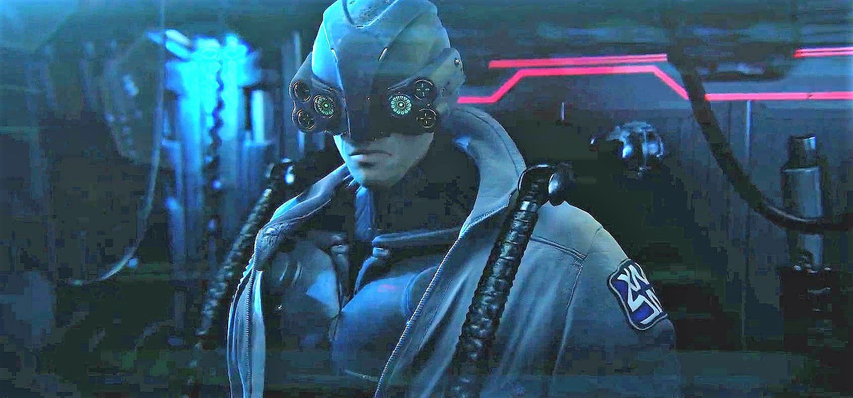
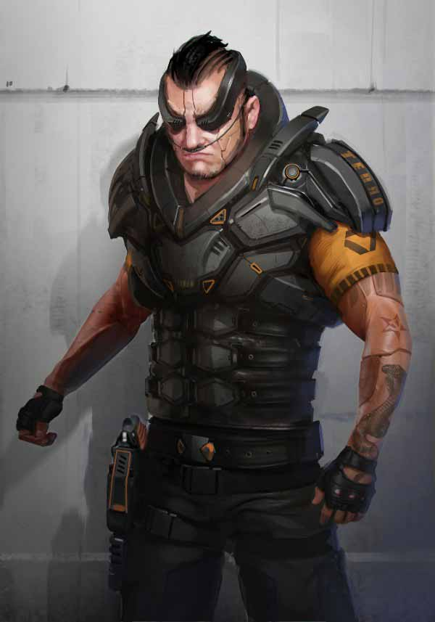
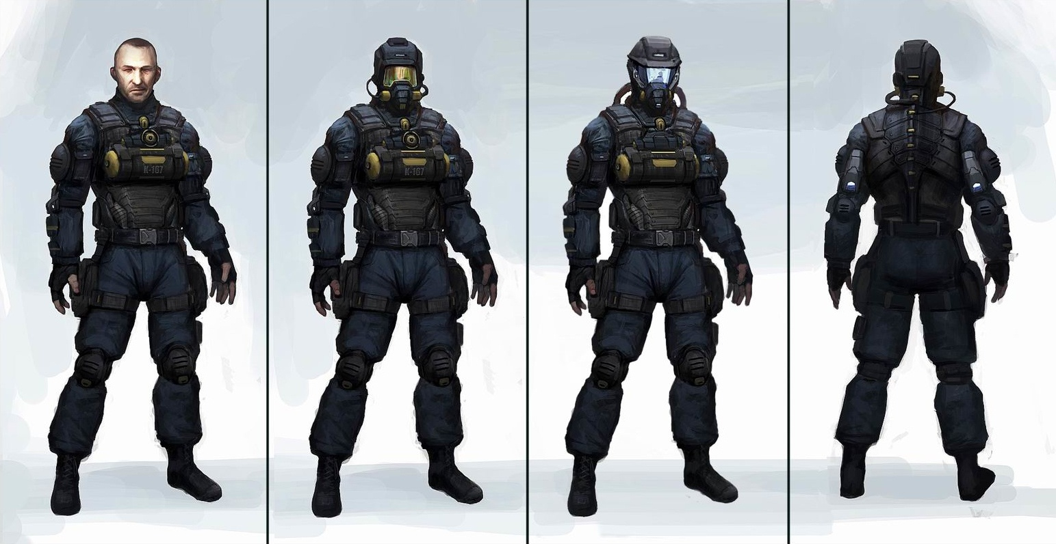
Cyberpunk Style

Slide 5
Cyberpunk Style
https://www.artstation.com/artwork/lnqZG

Slide 6
Cyberpunk Style
Big contrast between black areas and iluminated areas
Artificial light -> multiple sources
Very soft directional light
Never white lights
Very reflecting materials
Objects tinted with coloured lights
Very bright lights, but with close range.

Slide 7


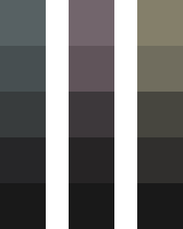
Color Palette
Main Colors
Secondary Colors
Blacks
Very saturated
Saturation < 50%
Don’t use 100% black
Increasing brightness
Mix black with primary colors

Slide 8
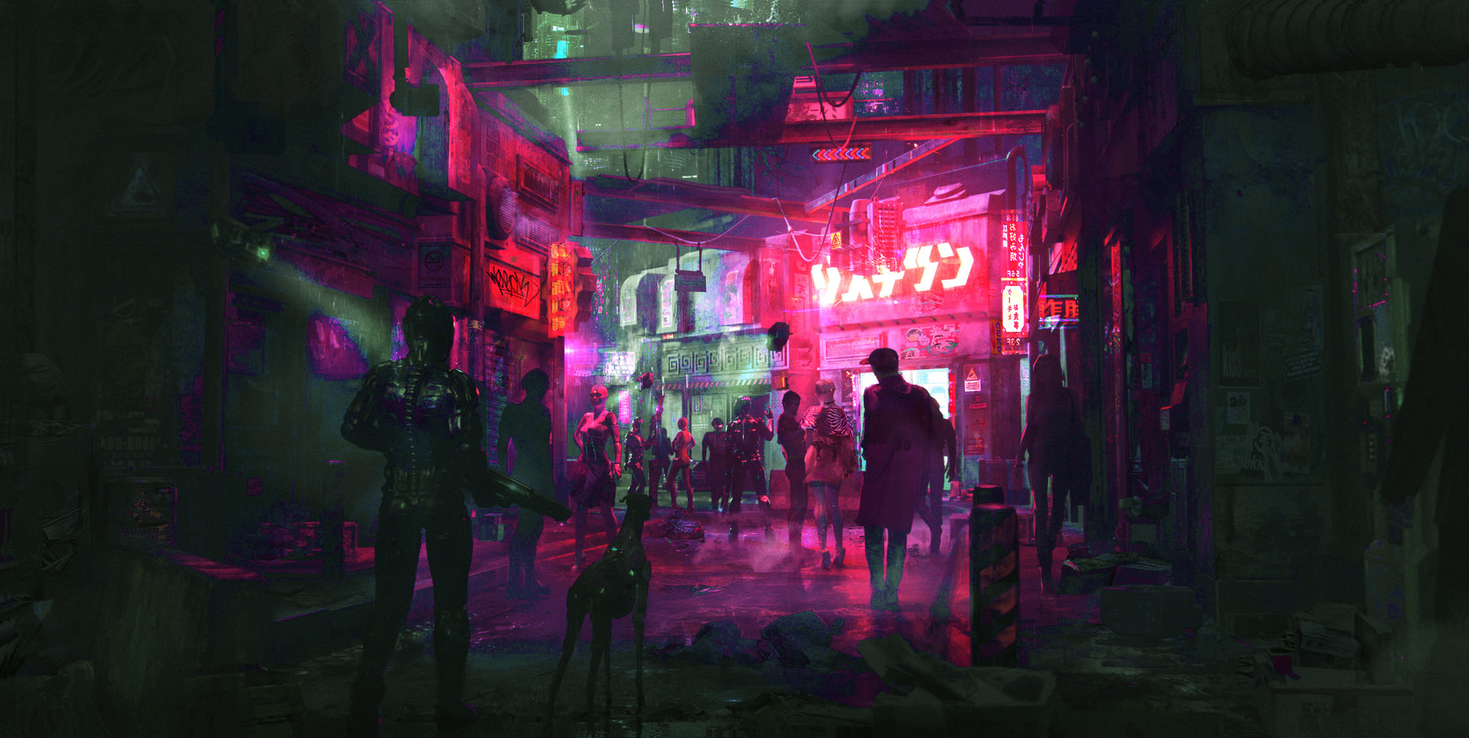
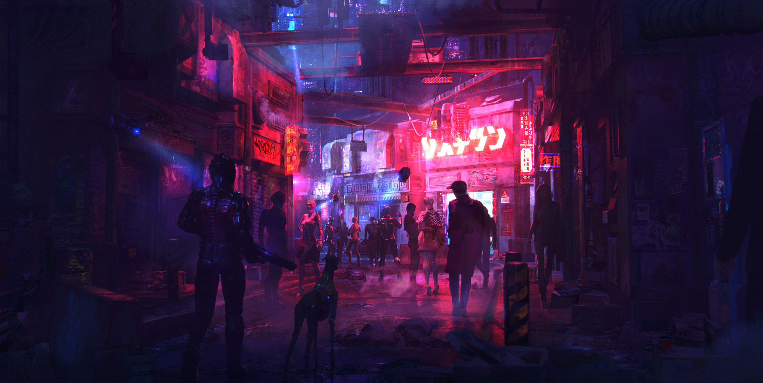
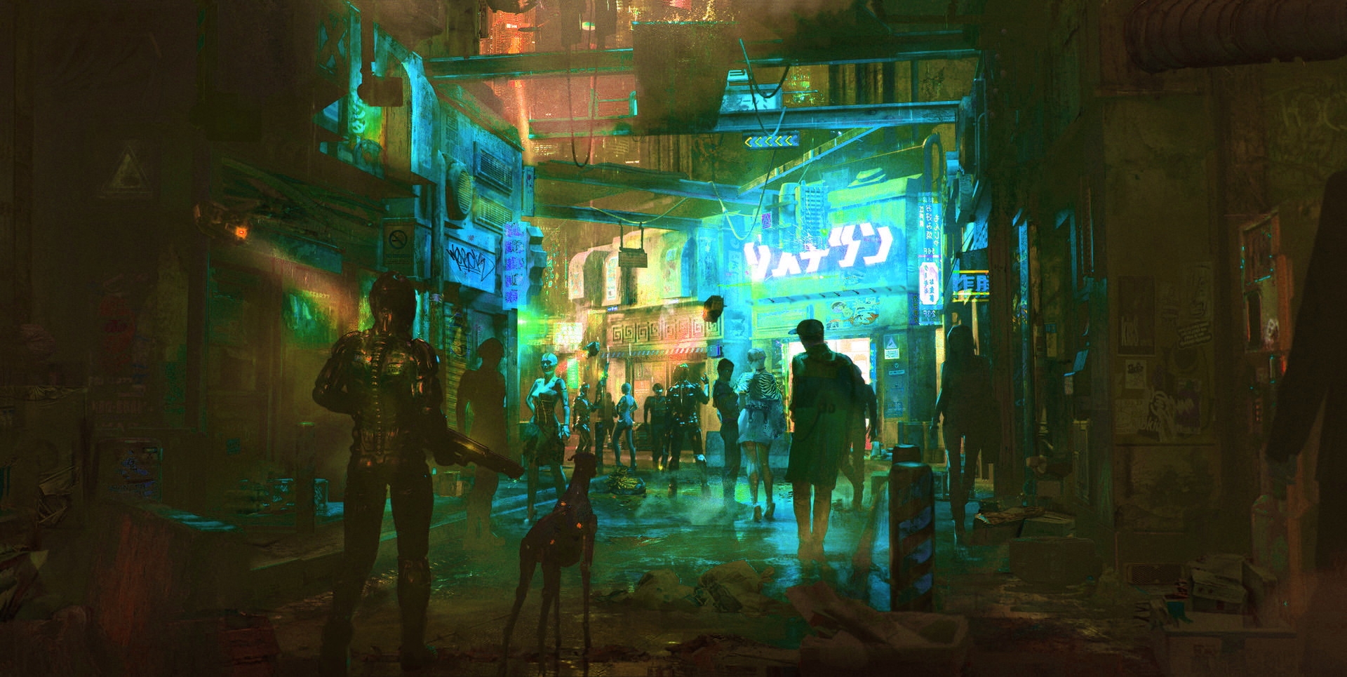
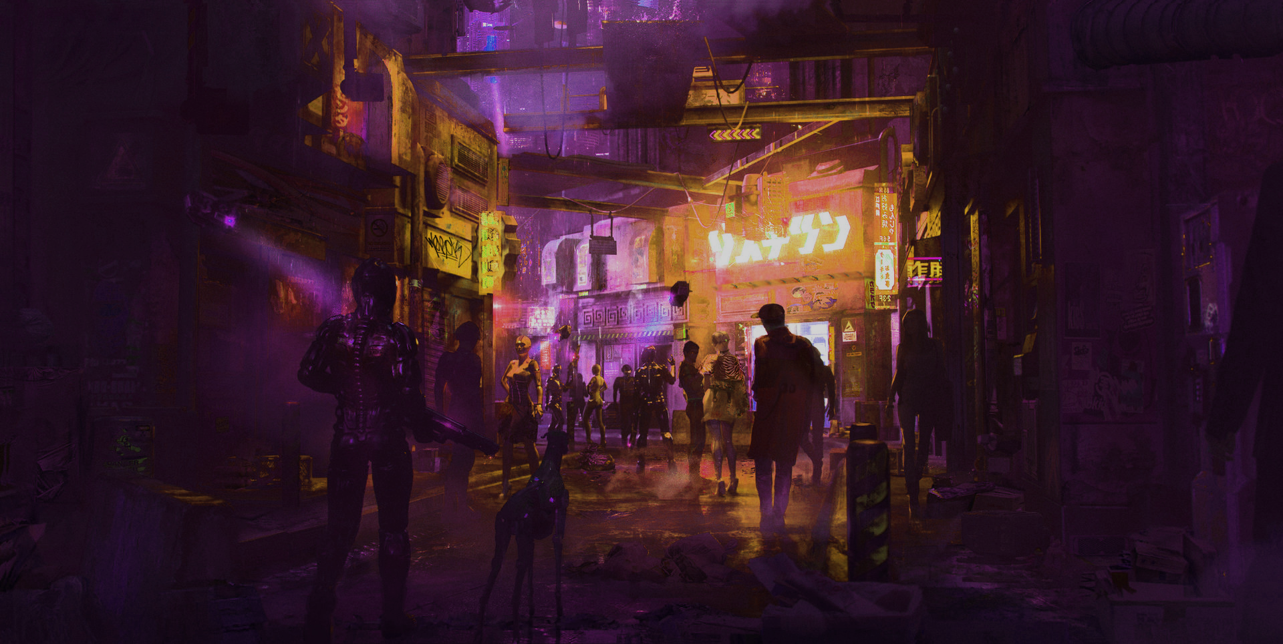
Lighting

Slide 9
Streets

Slide 10
Interiors

Slide 11
Addvertisements

Slide 12
Floor

Slide 13

Main Character

